Slide 1



Electrogoniometer for gait analysis
Potentiometer
TEAM 4:
BOUQUILLON Mylène, 10905159
DESIDE Guillaume, 10905967
MATERNE Sophie, 10872639
MEDRANO Estanislao, 10916969
PESKIR Aleksa, 10877580
SCHNIRER Tobias, 10912716
Technologies for sensors
and clinical instrumentations
ALIVERTI C.
PAGANELLI C.
ANGELUCCI A.
POLIMI – 06/06/2023

Slide 2

INTRODUCTION – Gait analysis
Angular variations of the body joints (hip, knee, ankle)
Joint limitations, individual therapeutic needs, tailored rehabilitation plans, athletes performances, feedback for prosthetic control systems, ...
Continuous monitoring
Daily activities
→ Functionnal status of the patient
Electrogoniometer for gait analysis
Potentiometer
(small size, long life span, ease of use, clothing interferences)
Arduino microcontroller
(compact size, robust, extensive community support)

Slide 3
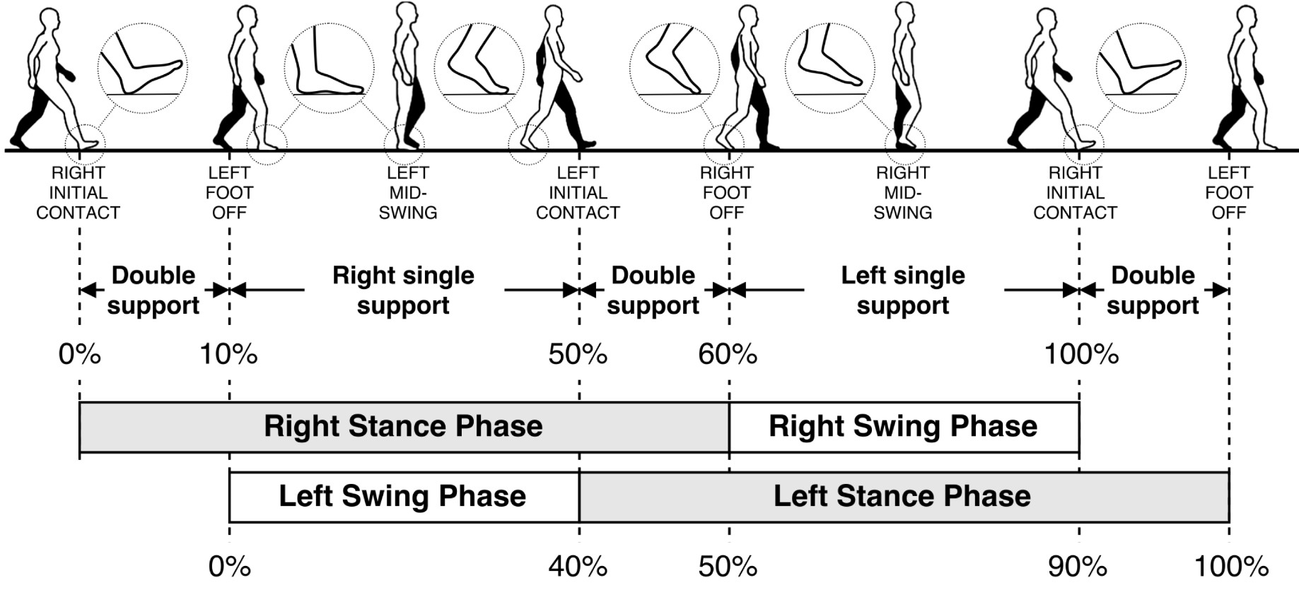
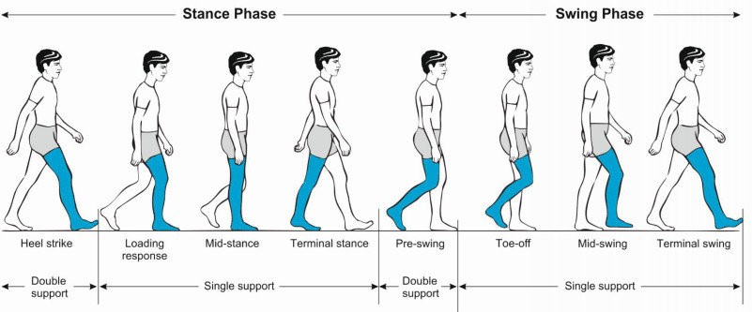
INTRODUCTION – Phases of the walk

Slide 4
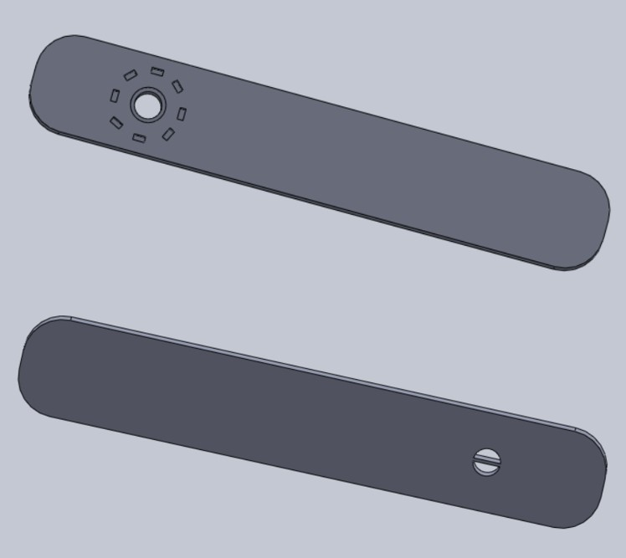
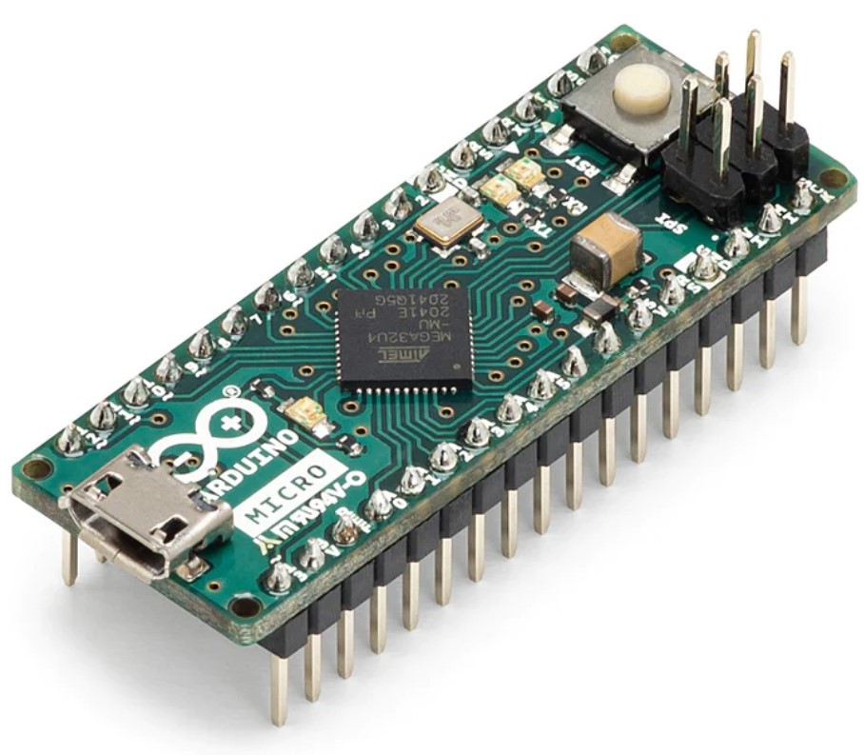
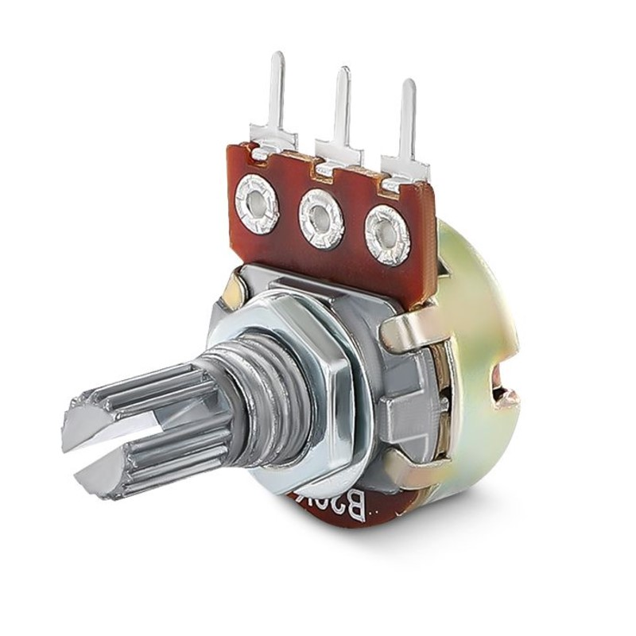
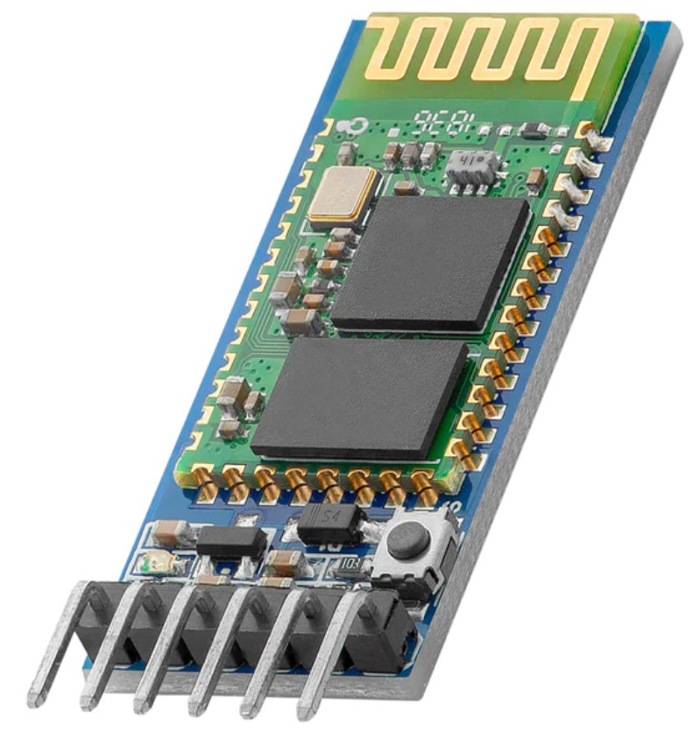
HARDWARE - Components
3D structure
Arduino microcontroller board
Potentiometer
Bluetooth module

Slide 5
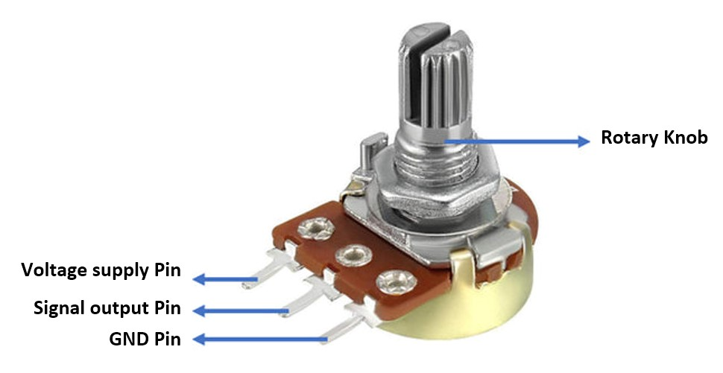
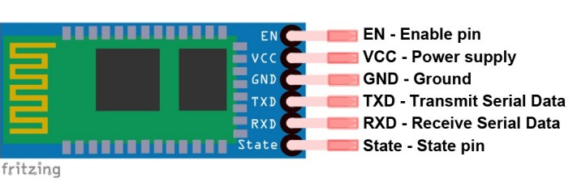
HARDWARE - Connections
Arduino | Potentiometer
A3 | Signal output Pin
5V | Voltage supply Pin
GND | GND Pin
Arduino | Bluetooth
10 | TX (= TXD)
11 | RX (= RXD)
5V | VCC
GND | GND

Slide 6
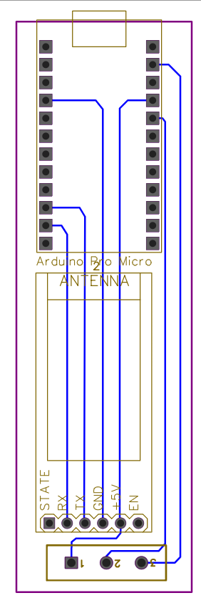
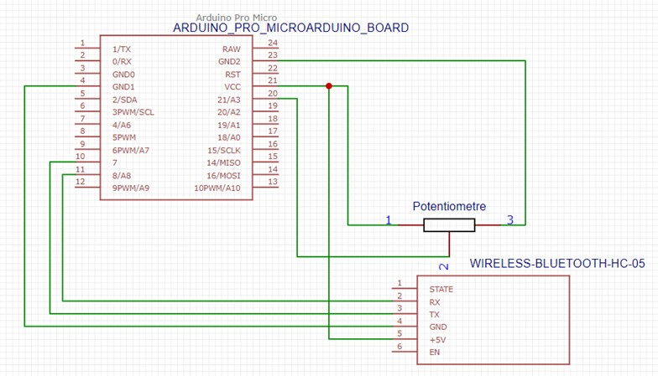
HARDWARE – Printed Circuit Board

Slide 7
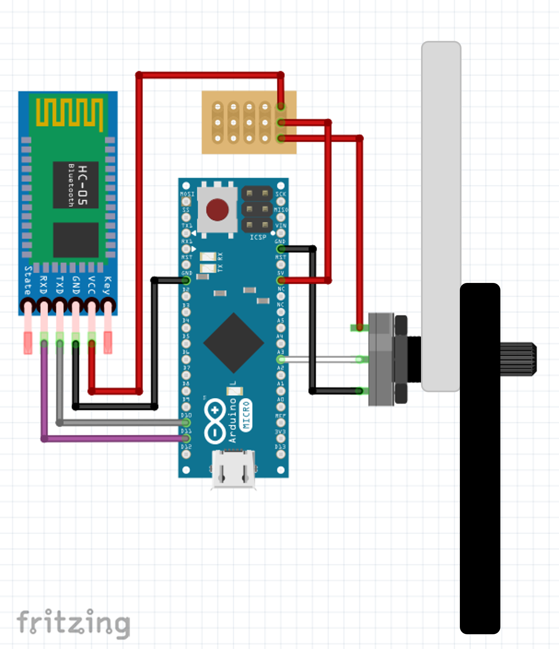
HARDWARE – Fritzing

Slide 8
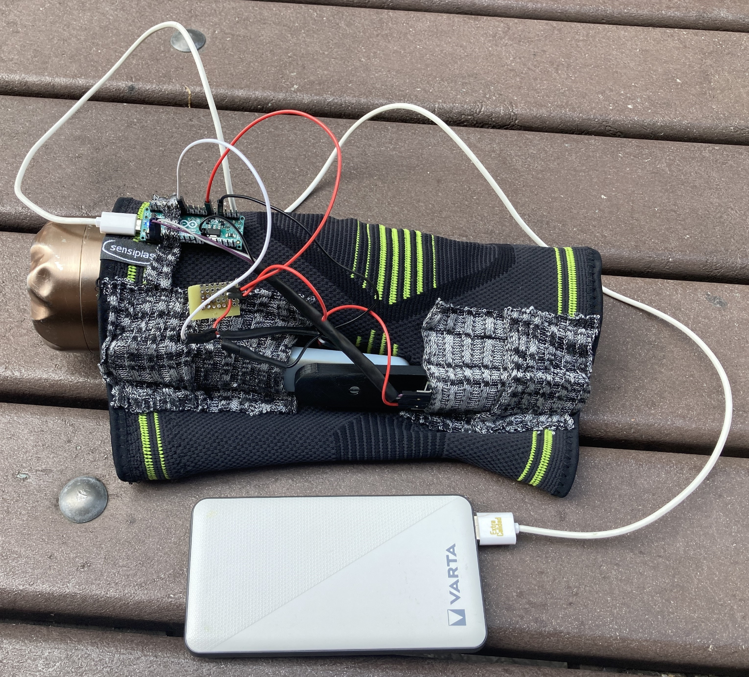
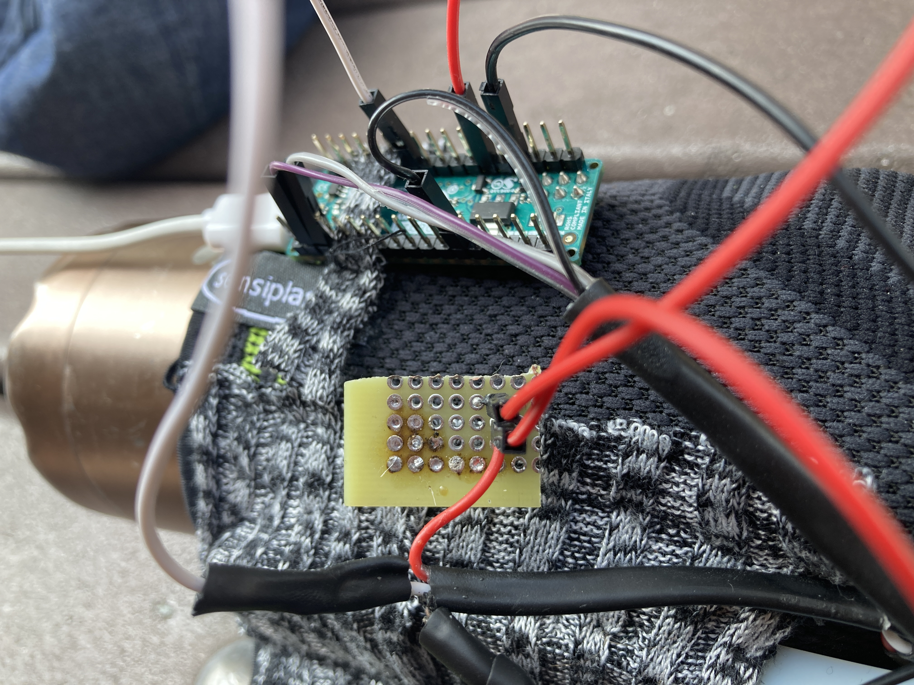
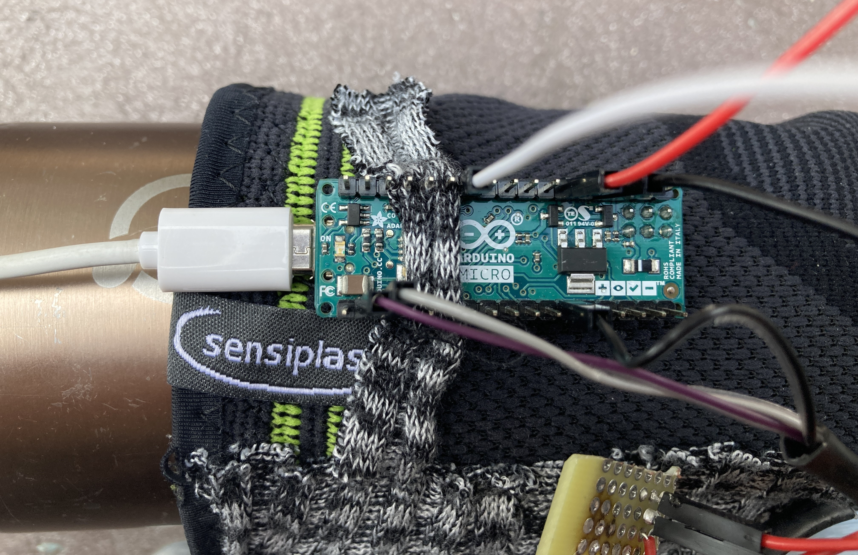
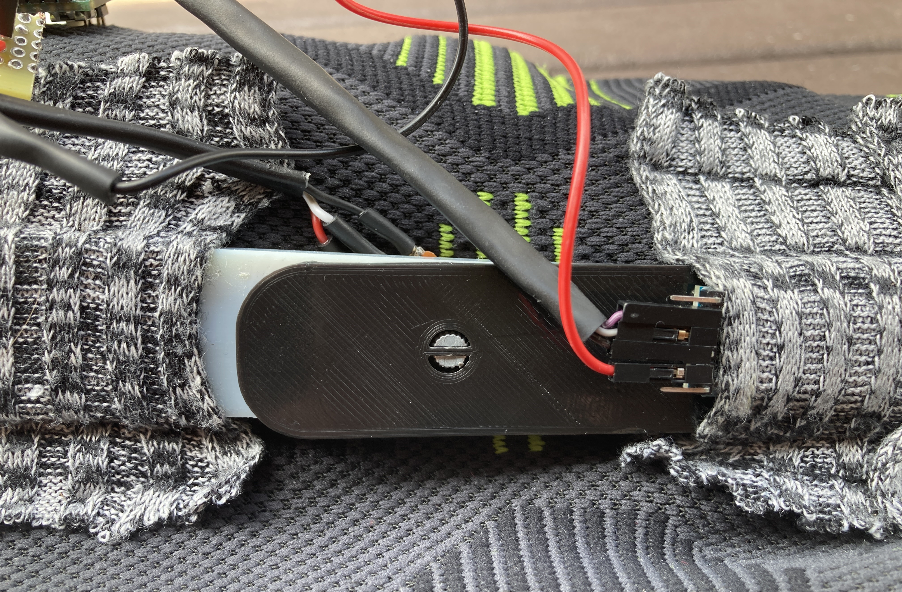
HARDWARE – Assembly

Slide 9

THANK YOU Any questions?

Slide 10
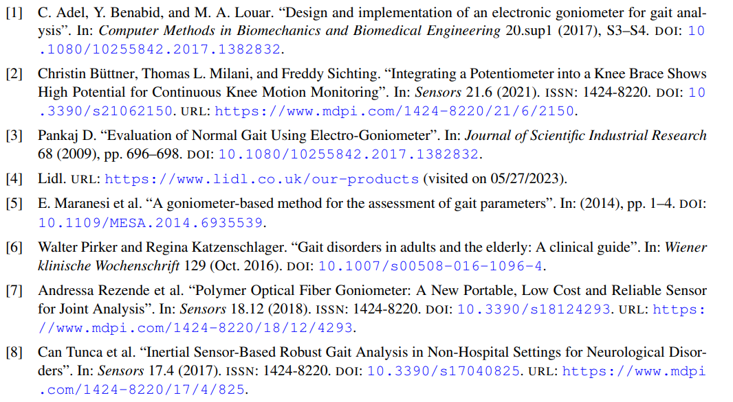
REFERENCES

